Slide 1
A Systems Approach to Waste Management
Dr. Nikhil K. Kothurkar

Slide 2
Outline
Motivation
Conventional Approach
Systems Approach: Principles for Optimizing the Waste Management Method
Example: Simple vs. Complex Systems
Amplify Benefits
Waste Disposal Priorities
Plastic Waste
Dry Biomass
Human Waste
Animal Waste
Organic Waste
Towards a Sustainable Home

Slide 3
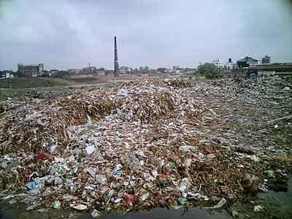
Solid Waste generated in Indian cities and towns:
In 1947 was 6 million tonnes
In 1997 about 48 million tonnes
Notes:
*

Slide 4
India's Solid Waste Problem
More than 25% of the municipal solid waste is not collected at all!
70% of the Indian cities lack adequate capacity to transport it
There are no sanitary landfills to dispose of the waste
~50% of municipal solid waste is organic in nature (potential manure/compost).

Slide 5
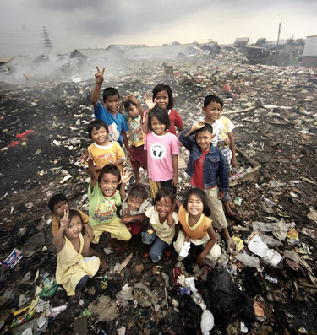
What an inheritance to leave for our children!
Notes:
*

Slide 6
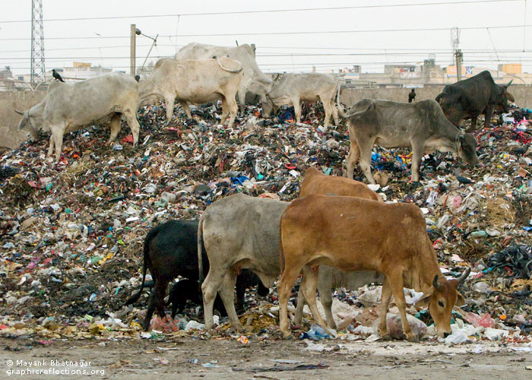
Where do you think our milk comes from?
Oops! Do our kids drink this stuff?
Notes:
*

Slide 7
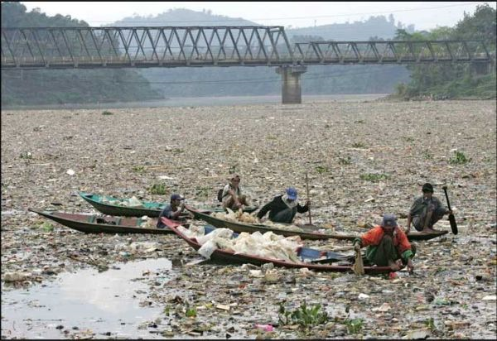
Ram Teri Ganga Maili Ho Gayi!
Notes:
*

Slide 8
Outline
Motivation
Conventional Approach
Systems Approach: Principles for Optimizing the Waste Management Method
Example: Simple vs. Complex Systems
Amplify Benefits
Waste Disposal Priorities
Plastic Waste
Dry Biomass
Human Waste
Animal Waste
Organic Waste
Towards a Sustainable Home

Slide 9
Conventional Approach
CHANGE OF ATTITUDE TOWARDS WASTE
Waste is not waste. It is merely a misplaced resource
It can be converted to manure, energy or other products.
But for it to be used as a resource, it has to be separated
There is no waste in Nature. Nature converts, recycles and reuses all wastes. The waste of one organism is the food of another.
Notes:
*

Slide 10
Waste Management Case Study:
Amrita Vishwa Vidyapeetham Campus, Coimbatore
Before 2008, campus waste was deposited by residents in the waste bins without segregation….

Slide 11
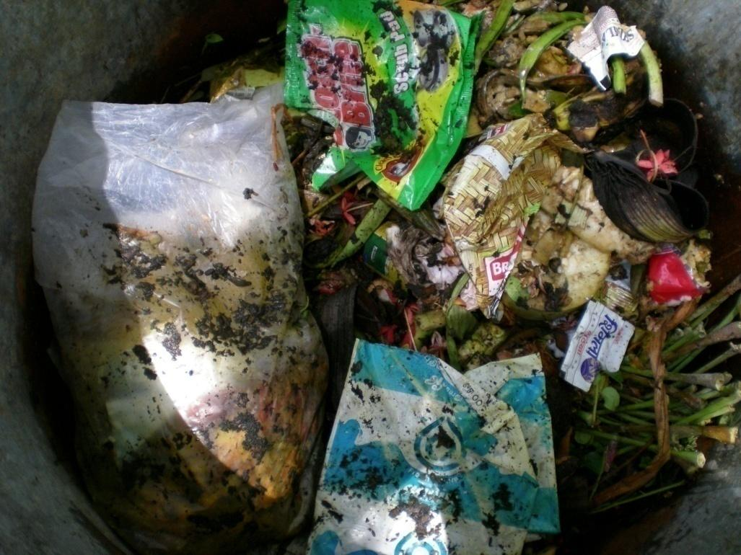
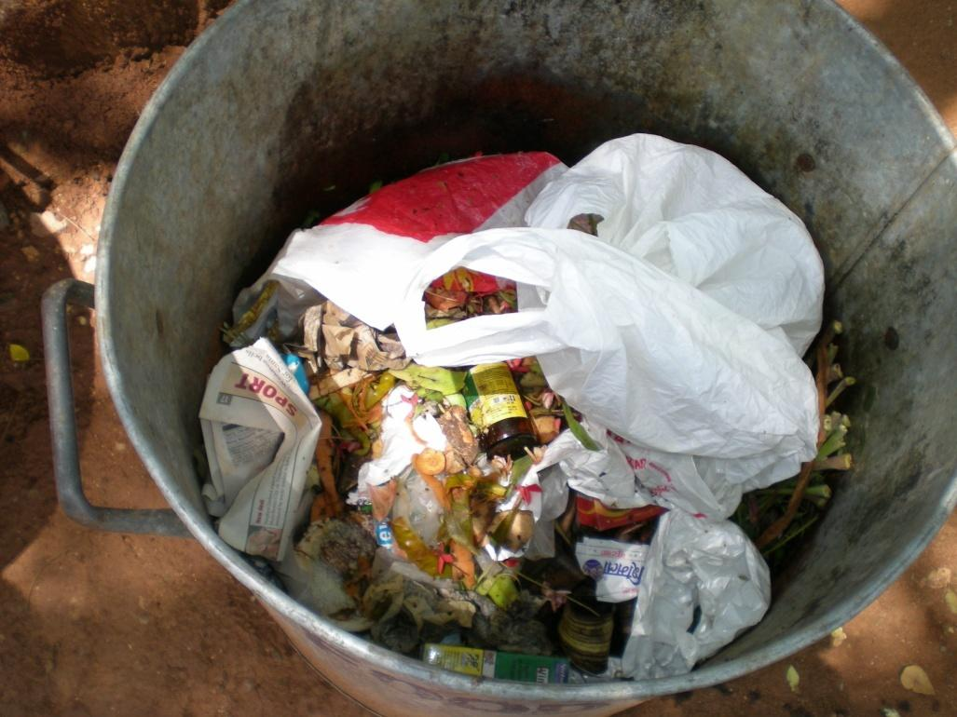
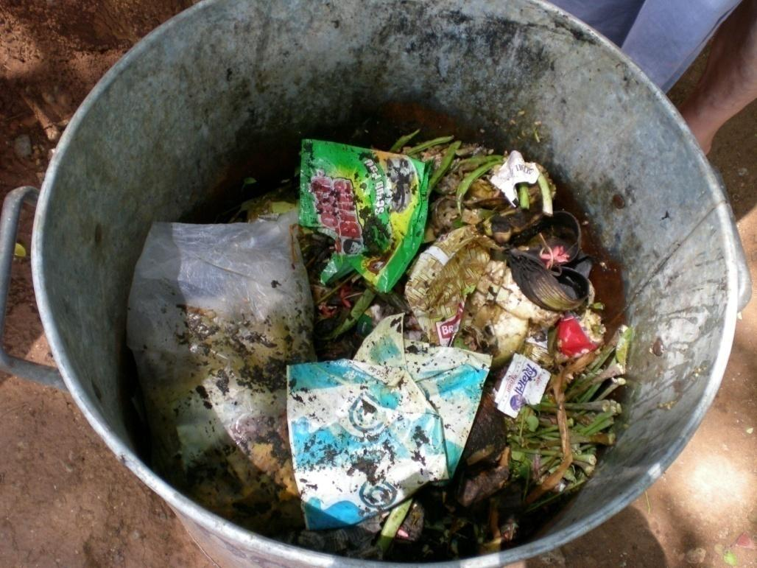
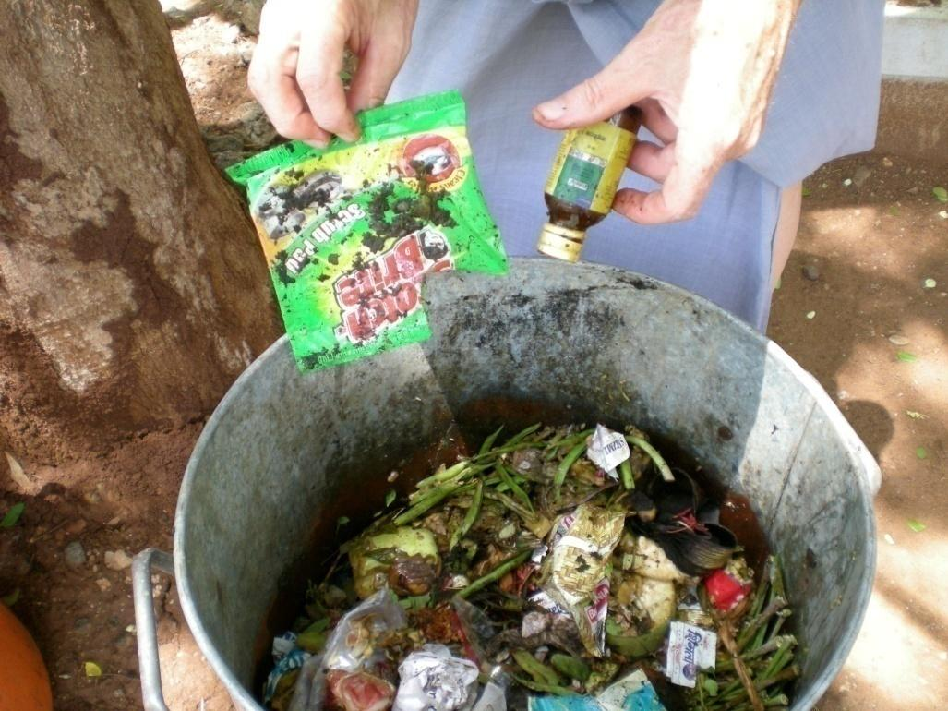
Which recycler will accept soiled paper or plastic for recycling?
Notes:
*

Slide 12
Problems with Dumping of Mixed Wastes
Health hazard to waste pickers and sorters: Bad odour and the risk of infection
Socially Demeaning and objectionable to sort through personal sanitary wastes and food waste, which are mixed with all the other waste.
Inefficient Recycling: Many recyclable items cannot be recycled since they are heavily soiled
Environmental Damage: Soiled recyclables have to be buried or incinerated leading to environmental damage.
Sorting is a tedious and labor intensive process
Notes:
*

Slide 13
A Responsible Waste Management Strategy
Waste can potentially be a boon or a bane depending upon the management strategy.
Boon: it can yield energy, reusable materials, raw material for processes.
Bane: environmental damage and pollution, disease and health problems.
Separate wastes at source (every house). Try to reuse at source, whenever possible.
Collect different categories of waste and transport to central sorting center.
Further sort into several categories at the sorting center.
Find markets for selling the various categories of sorted wastes.
Minimize exposure of workers to hazardous and offensive conditions
Notes:
*

Slide 14
Waste Segregation at Source
In 2008, waste segregation at source was implemented.
In common areas, four categories of bins were placed.
Bins for different categories were provided to residents, within their house.
Training of campus residents, staff and house-maids was conducted.

Slide 15
SEPARATION AND BIN COLOR CODING
(Amrita Ettimadai Campus)
Organic/Food waste | kitchen waste, food leftovers, vegetables, flowers, leaves, fruits.
Recyclables | Only dry paper, plastics, carry bags, etc.
Sanitary Waste | Personal and hospital waste such as sanitary pads, cloth or bandages soiled with blood and other body fluids.
Other waste | Milk pouches, badly soiled paper and plastic, coconut shells, glass, metals, foil, paints, chemicals, bulbs, spray cans, fertilizer and pesticide containers, batteries, shoe polish, tubelights, old medicines.
Notes:
*

Slide 16
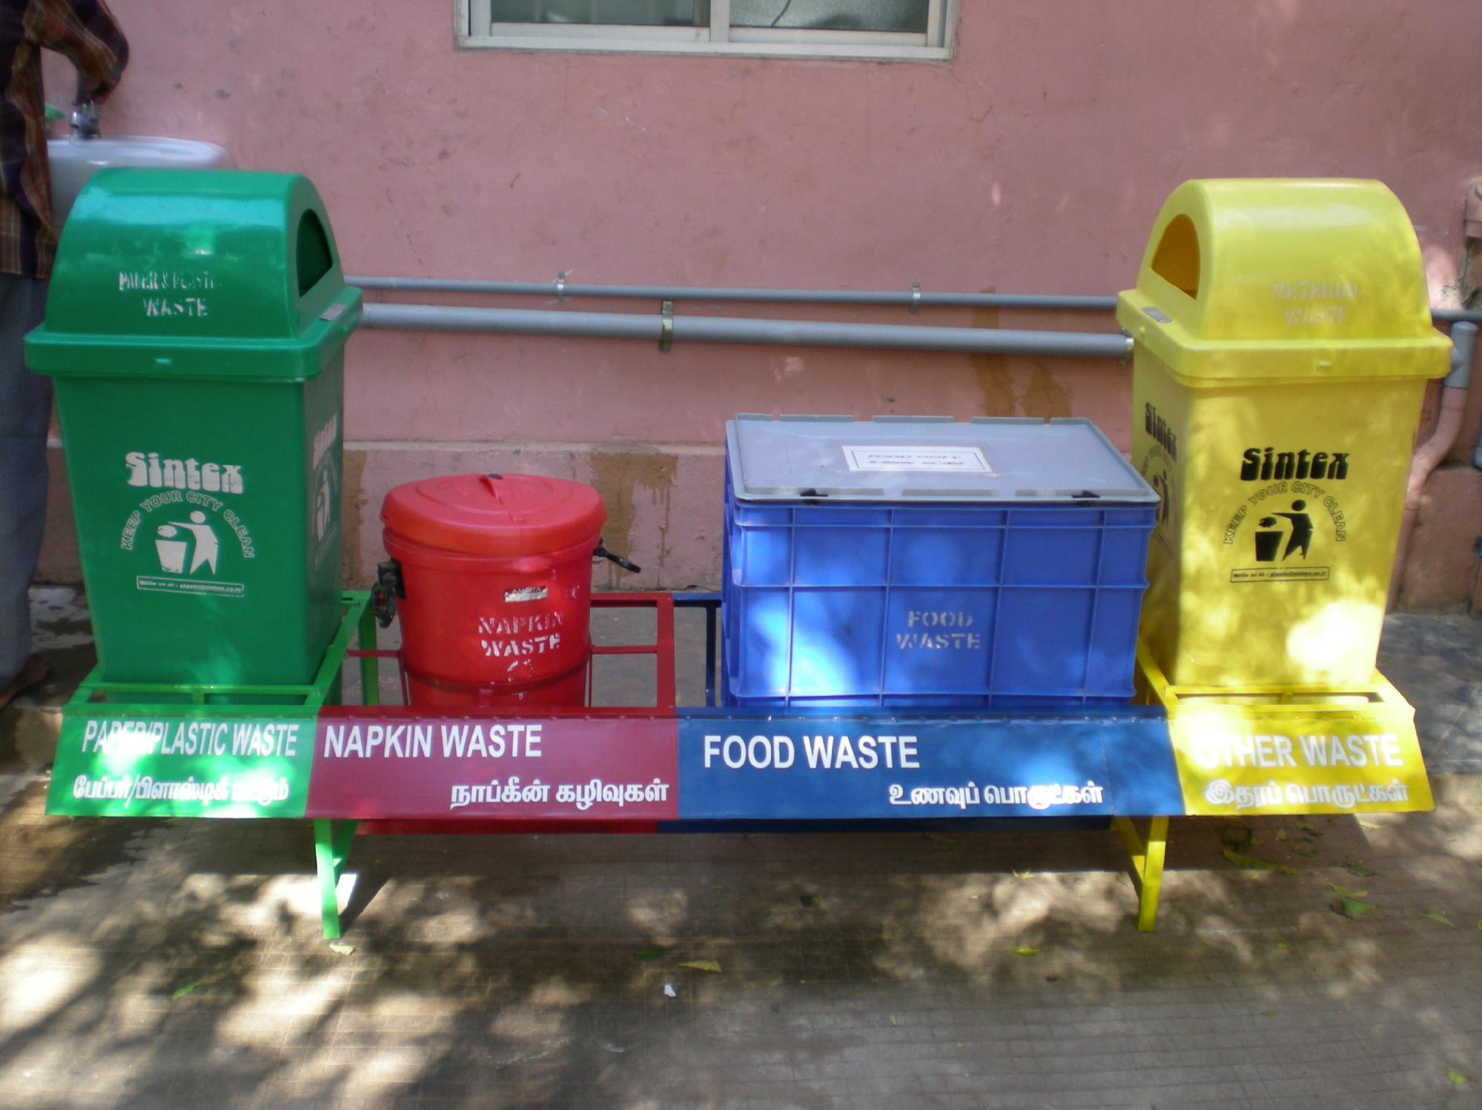
Notes:
*

Slide 17
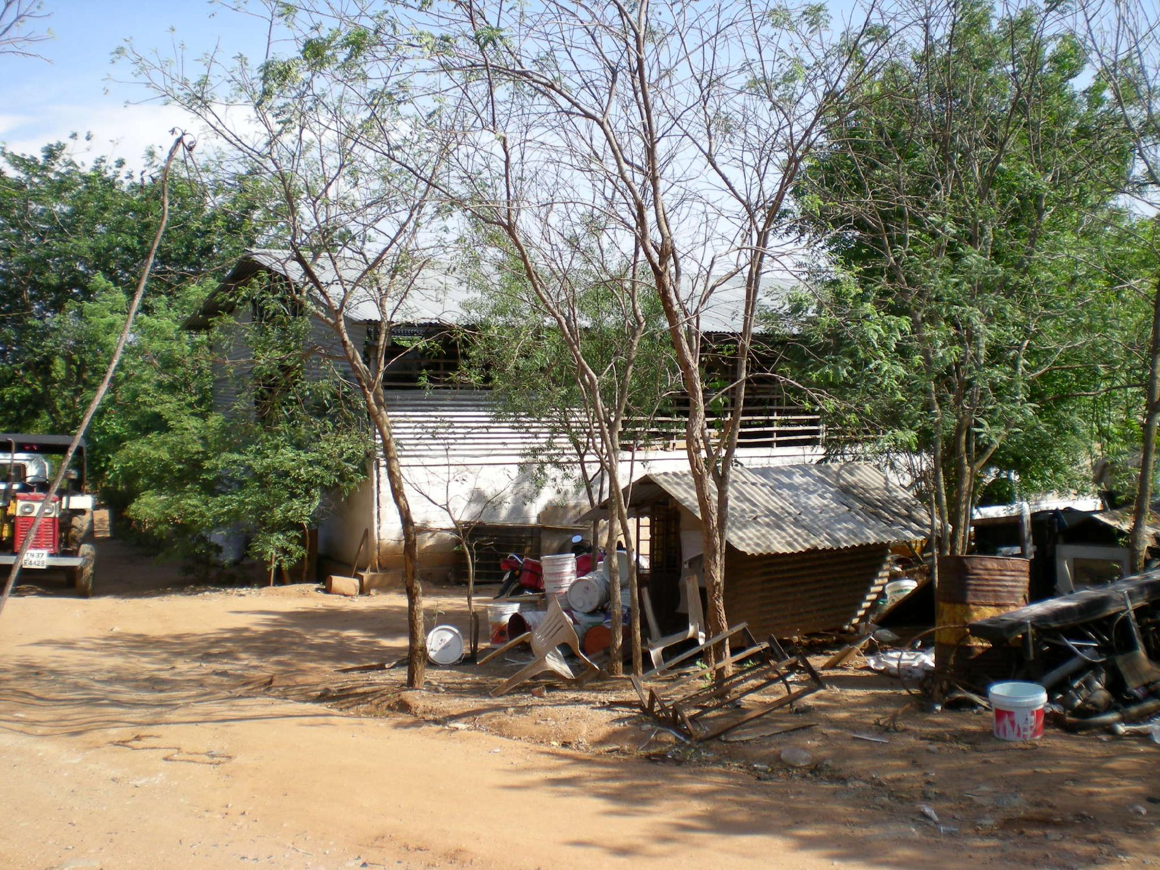
AMRITA RECYCLE CENTER (ARC)
Notes:
*

Slide 18
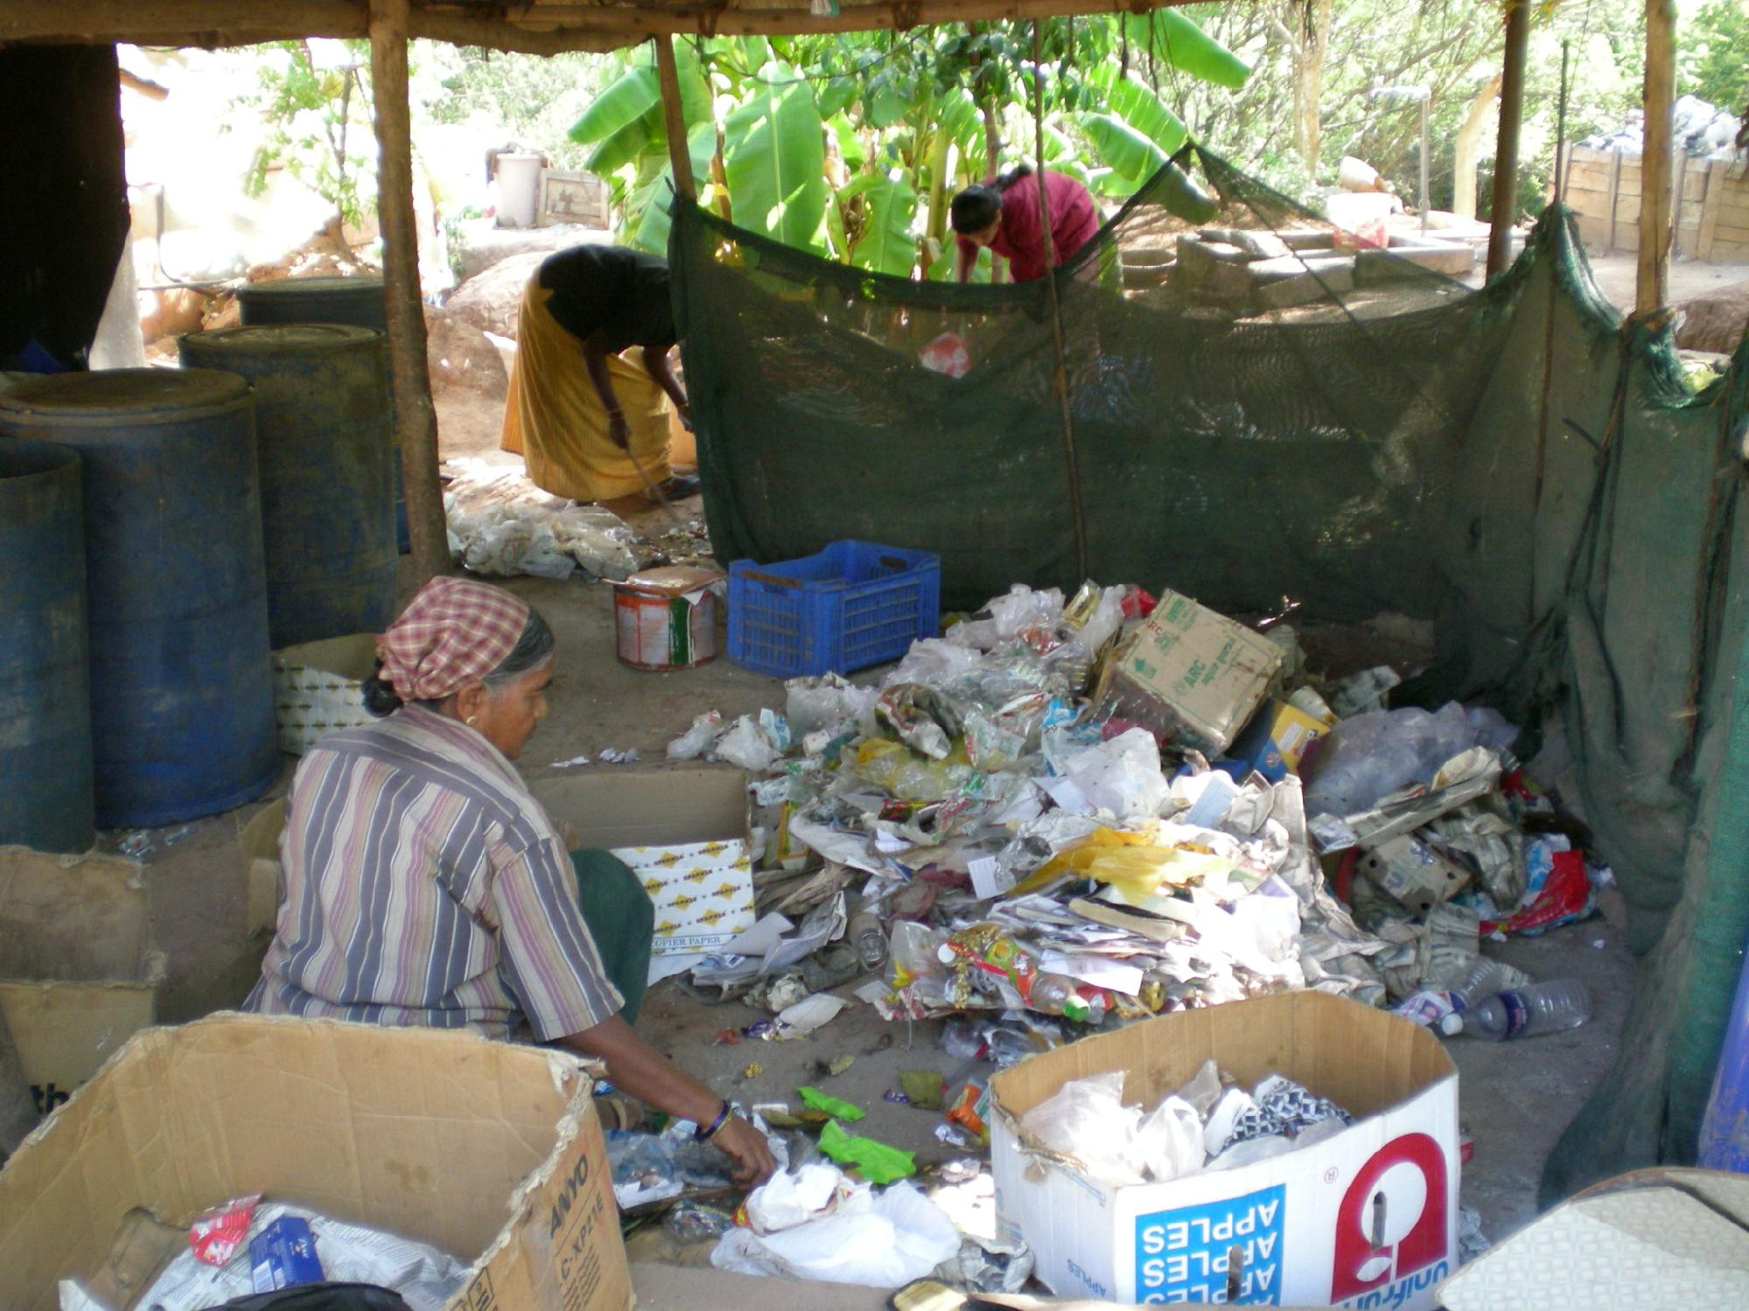
Further Manual Sorting of Waste
Notes:
*

Slide 19
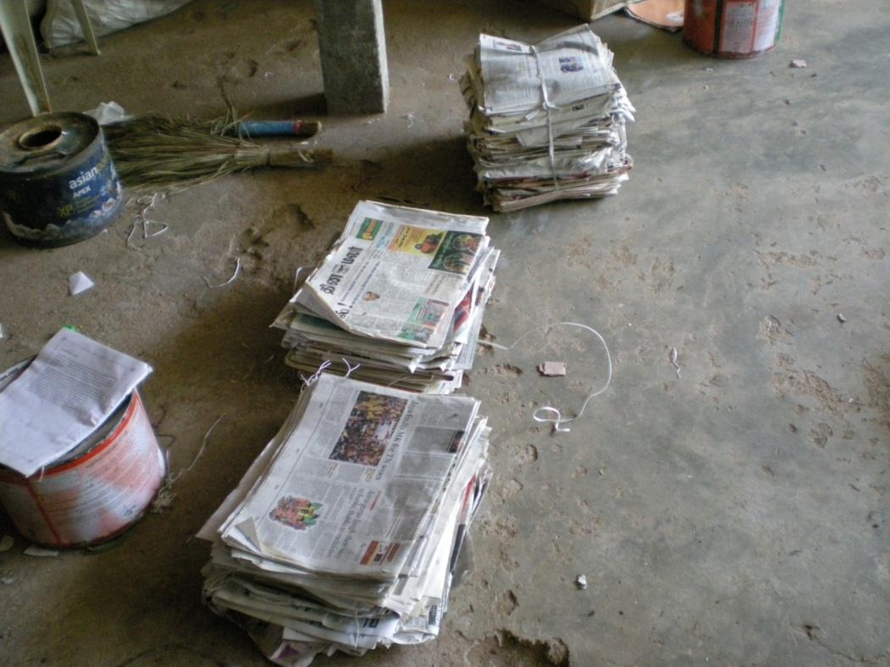
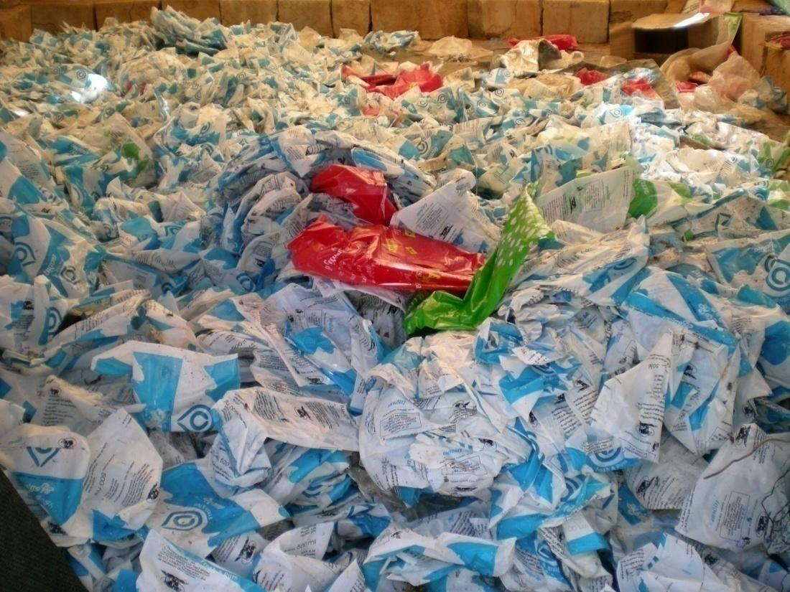
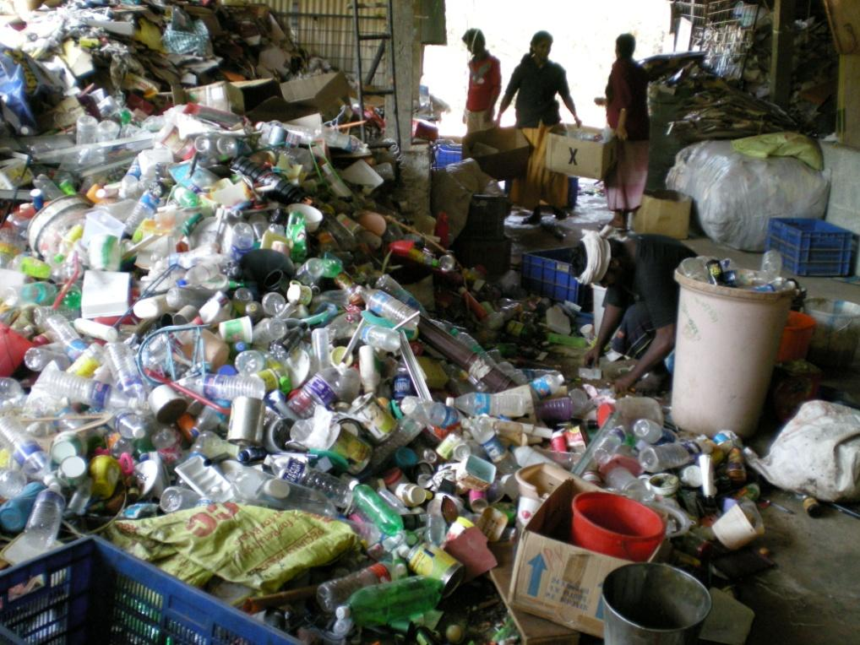
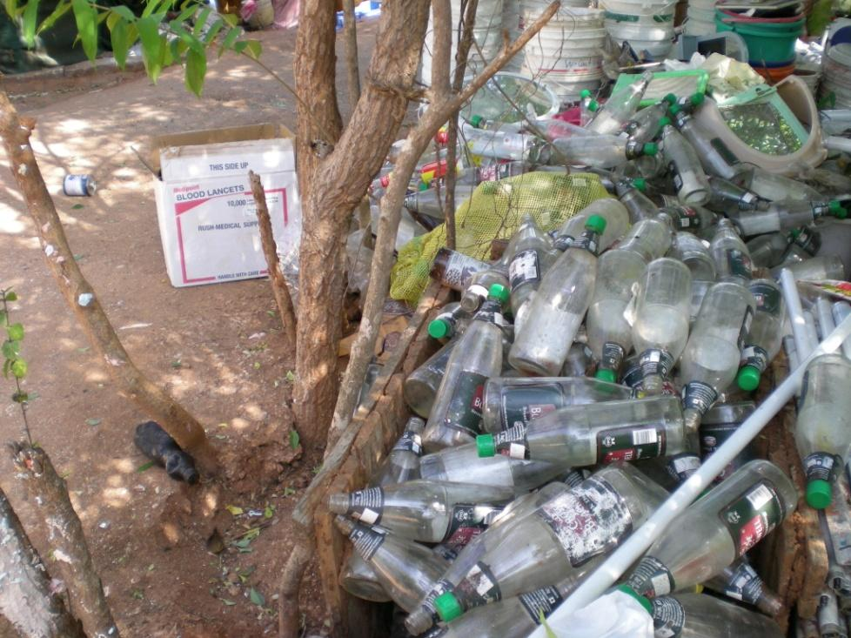
Notes:
*

Slide 20
AMRITA HAS MADE A DIFFERENCE
Every bit of waste on campus is collected and taken to the Amrita Recycle Center (ARC).
Manual sorting of wastes
Organic (food) waste is composted: manure for orchards
Recylables are recycled
Non-recyclabes are incinerated
Effluent treatment plant for campus liquid effluent.
True to the teachings of Amma, we take responsibility for protecting Nature and our fellow-humans
Notes:
*

Slide 21
RESULT
A clean campus, free from litter and pollution.
Organic gardens and orchards
Protection of the environment
Recycling of paper, plastics, scrap metal, glass and other recyclables
Notes:
*

Slide 22
Outline
Motivation
Conventional Approach
Systems Approach: Principles for Optimizing the Waste Management Method
Example: Simple vs. Complex Systems
Amplify Benefits
Waste Disposal Priorities
Plastic Waste
Dry Biomass
Human Waste
Animal Waste
Organic Waste
Towards a Sustainable Home

Slide 23
Systems Thinking
●Systems thinking is necessary for solving interconnected problems.
●The WHOLE is more than just the sum of the individual PARTS.
oE.g. Putting together all the parts of a car in any random order does not make a functional car.
oEach part is related to other parts in a specific way and contributes to the functioning of the whole.
oDesign is necessary both at the component level and the system level. (e.g. each part must be properly designed and the entire car must also be properly designed.)
oDiagnosing and correcting malfunctions in complex and interrelated problems requires systems thinking.
oWatch this video Systems thinking: an introduction (3.31 min)
oSystems thinking: a cautionary tale (cats in Borneo) (3.08 min)

Slide 24
Systems Approach
Select the best among the several possible waste management strategies
Integrating solid waste management with gardening, milk production, water management and energy systems, can give very high returns.
Complex systems can give higher resource use efficiency but at a higher infrastructure and maintenance cost
Optimization is necessary.

Slide 25
Principles for Optimizing the Waste Management Method
Segregate waste at source
Collect spoilable (organic) waste from sources twice a day.
Tertiary seggregation at the collection center
Reuse is better than Recycle
Use each type of waste for the highest value application first.
Use the same materials as many times as possible for relatively lower value applications each time.

Slide 26
Principles for Optimizing the Waste Management Method
Convert wastes into value-added products
e.g. organic waste to compost for gardening.
Amplify the benefits drastically by:
Including microorganisms, plants, small and large animals in the method.
Integrating waste management with food and energy production and water management.
Balance between the high long term benefits of complex systems and the low immediate infrastructure cost of simple systems.
Beware of introducing or cycling toxins or pathogens in the human food chain.

Slide 27
Outline
Motivation
Conventional Approach
Systems Approach: Principles for Optimizing the Waste Management Method
Example: Simple vs. Complex Systems
Amplify Benefits
Waste Disposal Priorities
Plastic Waste
Dry Biomass
Human Waste
Animal Waste
Organic Waste
Towards a Sustainable Home

Slide 28
Food Waste
Garden/ Biomass Waste
Simple system
Low output of value-added products
Lower infrastructure
Lower long-term profitability
Composter
Agriculture
Food

Slide 29
Food Waste
Garden/ Biomass Waste
Complex system
Very high output of value-added products
Greater long-term profitability
Higher infrastructure
Complexity is not always advantageous
Cattle-edible
Cow
Cattle-inedible
Pyrolyzer
Dung
Biogas Plant
Mulch
Biochar
Urine
Slurry
Syn Gas
Biogas
Agriculture
Milk
Food
Heating/ Power generation

Slide 30
Outline
Motivation
Conventional Approach
Systems Approach: Principles for Optimizing the Waste Management Method
Example: Simple vs. Complex Systems
Amplify Benefits
Waste Disposal Priorities
Plastic Waste
Dry Biomass
Human Waste
Animal Waste
Organic Waste
Towards a Sustainable Home

Slide 31
Amplify the Benefits
Food waste --> Landfill with other solid waste --> Pollution and GHG emissions, breeding of vectors and diseases, loss of value of recyclables, contamination of groundwater --> net loss.
Food waste --> composting --> sell compost --> earn profits.
Food waste --> Cow --> milk and dung
Sell milk (or consume) --> earn profits (or displace expenses)
AND compost the dung
--> sell the compost --> earn profits
OR --> grow vegetables on greywater --> sell vegetables --> greater profits

Slide 32
Amplify the Benefits
For a certain type of organic waste:
Identify an organism (plant or animal) that consumes it and yields a human-useful product e.g. a cow, goats, egg-laying birds
Among the alternatives, choose the organism which:
is robust and requires minimal care,
has a high resource conversion efficiency
yields products of high value.
Explore if an integrated management of solid waste, energy, food, liquid effluent gives any significant advantages.

Slide 33
Domestic Effluent (Sewage)
Simple system
Low output of value-added products
High external inputs
Lower infrastructure
Lower long-term profitability
Effluent Treatment Plant
High electricity, inputs
Sludge
Land Application
(Pollution?)
Reclaimed Water

Slide 34
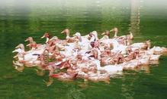
Domestic Effluent (Sewage)
Complex system
High output of value-added products
Low external inputs
Higher infrastructure
Drastically higher long-term profitability
Open wetland with ducks
Plant Biomass (e.g. water hyacinth, algae)
Biogas or Pyrolyis Plant
Reclaimed Water
Eggs
Energy
http://www.indiangreenservice.com/resources.html

Slide 35
Outline
Motivation
Conventional Approach
Systems Approach: Principles for Optimizing the Waste Management Method
Example: Simple vs. Complex Systems
Amplify Benefits
Waste Disposal Priorities
Plastic Waste
Dry Biomass
Human Waste
Animal Waste
Organic Waste
Towards a Sustainable Home

Slide 36
Plastic Waste Usage Priorities
Plastic waste should be used in the following order of priority. Only if unfit for one category should it be used for the next:
Reuse the plastics (materials and products) for a lower value application. Caution: Do not reuse plastics for food or drinking water applications due to toxicity hazard.
Segregate based on type and recycle to make lower quality products.
Poor quality plastic waste can be converted to fuel (gas or liquid) by pyrolysis techniques.

Slide 37
Dry Biomass Waste Usage Priorities
Agricultural biomass residue or garden waste biomass should be used in the following order of priority. Only if unfit for one category or present in excess or requirements should it be used for the next:
Feed and bedding for milch animals.
Ground mulch (shredded or unshredded as convenient) for agriculture...cattle bedding is ideal.
Feed for biogas plant...use effluent slurry for food farming.
A small fraction of dry biomass can be converted to fuel (gas or liquid) by pyrolysis techniques.

Slide 38
Human Waste Usage Priorities
Human waste should be disposed of and used in the following order of priority. Only if the first is not feasible should the subsequent ways be adopted:
Use urine separation, dry composting toilets. Apply urine directly to trees and to herbaceous crops only if using drip irrigation. Use compost after due ageing (eliminate pathogens) to fertilize tree crops. Avoid applying to herbaceous and root crops.
Send mixed human waste from flush toilets to wetlands or photobioreactors. Harvest biomass and convert to energy by pyrolysis or biomethanation. Residual biochar or waste sludge can be used for gardening.

Slide 39
Human Waste Usage Priorities
3. Send mixed human waste from flush toilets to a biogas plant. Waste sludge can be used for gardening.
4. Send mixed human waste directly into compost pit.
Check WHO Guidelines for the safe use of wastewater, excreta and greywater

Slide 40
Animal Waste Usage Priority
Animal waste should be disposed of and used in the following order of priority. Only if the first is not feasible should the subsequent ways be adopted:
Separate urine (esp. cow urine) and use for fertigation directly or after preparing liquid biofertilizers like Panchagavya via drip irrigation.
Send solid waste to biogas plants and recover energy (gas) as well the spent slurry. The slurry can be used as fertilizer preferably after vermicomposting or ageing.

Slide 41
Organic Waste Usage Priorities
Kitchen and food waste should be used in the following order of priority. Only if unfit for one category should it be used for the next:
Feed for milch animals (collect the milk and send dung to biogas plant)
Feed for egglaying birds (recover the eggs and send the excreta to the biogas plant)
Feed for Biogas plant (recover the gas and use the waste slurry for agriculture)
Direct Composting (use the compost for agriculture)
Feed for pyrolyzer/gasifier (recover the gas and use the biochar for agriculture)

Slide 42
Outline
Motivation
Conventional Approach
Systems Approach: Principles for Optimizing the Waste Management Method
Example: Simple vs. Complex Systems
Amplify Benefits
Waste Disposal Priorities
Plastic Waste
Dry Biomass
Human Waste
Animal Waste
Organic Waste
Towards a Sustainable Home

Slide 43
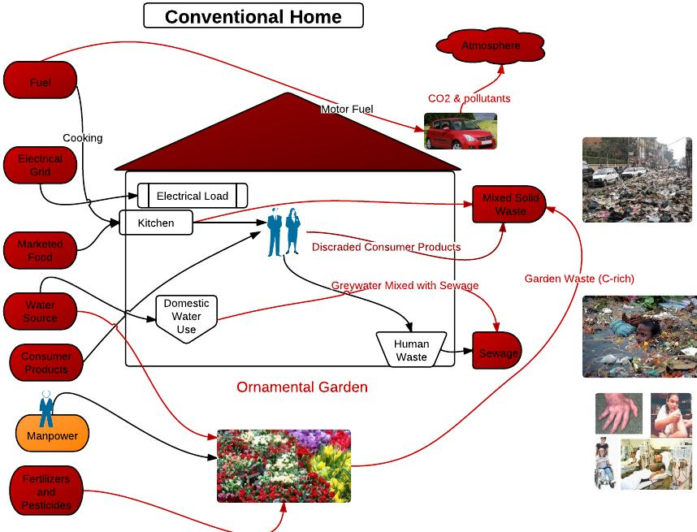

Slide 44
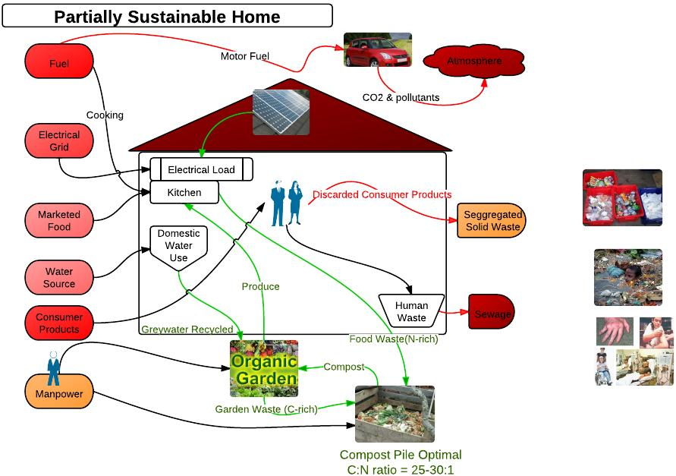

Slide 45
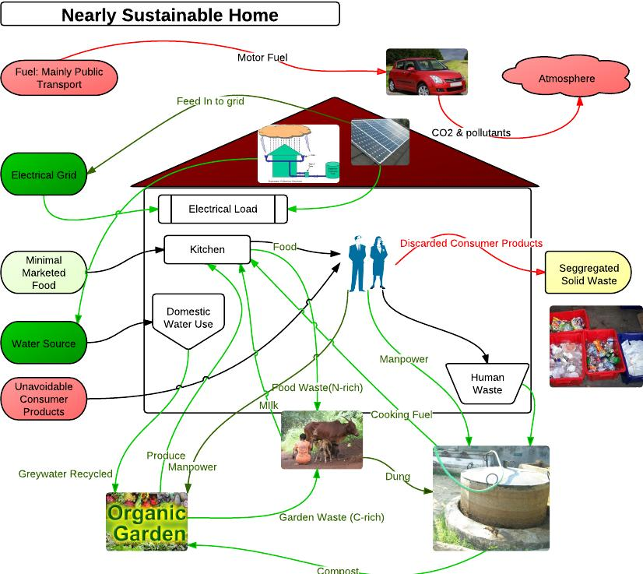

Slide 46
Links
Paradigm Environmental Strategies (P) Ltd.: Implementing sustainable and eco-friendly development projects including integrated waste management

